Slide 1
Car sales
Yearly Report

Slide 2
Problem statement:
Background: Our company is a car dealership that sells various car models. To effectively track and analyze our sales performance, we need a comprehensive Car Sales Dashboard in Power BI.
Objective: The objective of this project is to design and develop a dynamic and interactive Car Sales Dashboard using Power BI. The dashboard will visualize critical KPIs related to our car sales, helping us understand our sales performance over time and make data-driven decisions.

Slide 3
KPI’S Requirement
Sales Overview:
Year-to-Date (YTD) Total Sales.
Month-to-Date (MTD) Total Sales.
Year-over-Year (YOY) Growth in Total Sales.
Difference between YTD Sales and Previous Year-to-Date (PYTD) Sales.
Cars Sold Metrics:
Year-to-Date (YTD) Cars Sold.
Month-to-Date (MTD) Cars Sold.
Year-over-Year (YOY) Growth in Cars Sold.
Difference between YTD Cars Sold and Previous Year-to-Date (PYTD) Cars Sold.
Charts:
KPI visual to track whether the target has been achieved or not.
Pie chart to calculate market share.
Waterfall chart for Numbers of Cars Sold Distribution by Quarter and Body Style.
Table that shows YTD Total sales and PYTD Total sales both values and percent wise.

Slide 4
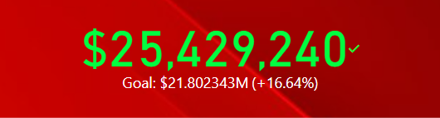
Key performance indicator (kpi)
Ford's current performance of $25,429,240 exceeds the goal of $21.802343 million by 16.64%, demonstrating strong market performance.

Slide 5
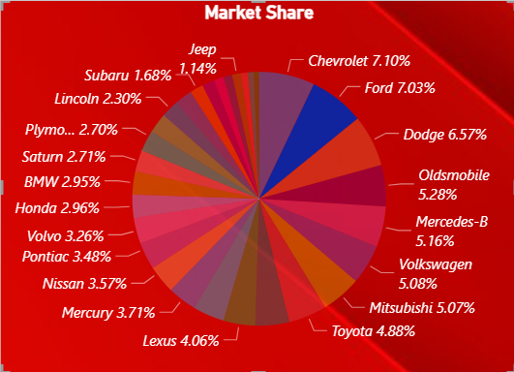
Market share
Ford has solidified its position with a commanding 7.03% market share. This figure underscores Ford's resilience and competitive edge in the automotive industry.
Not only ford almost all the leading brands has covered single digit market.

Slide 6
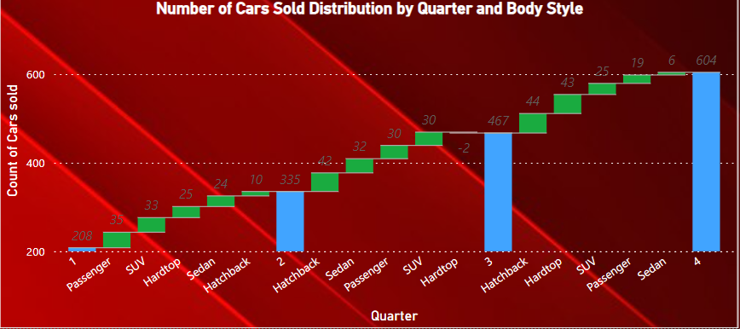
Number of Cars Sold Distribution by Quarter and Body Style
As we can see quarter wise the car’s sales market is increasing.
In Quarter 3 there was a slight decrease in car sales by -5.13% for Hardtop Body Style.

Slide 7
Insights
At our dealership, we're celebrating an impressive 39.86% surge in sales compared to last year, signaling strong consumer demand and our commitment to delivering exceptional vehicles and service.
Although Quarter 3 saw a minor dip of -5.13% in sales for Hardtop Body Style cars, our overall performance remains robust, with nearly 13K cars sold this year, contributing to a notable $371M increase in revenue.
Notably, automatic transmission vehicles from Dodge, Ford, Volkswagen, and Chrysler have dominated sales, while Chevrolet, Mercedes-B class, and Ford have led the pack in manual transmission sales.
Looking ahead, Quarter 4 has seen a notable uptick in sales across various body styles including Hardtop, Hatchback, Passenger, and Sedan cars, with SUV segment vehicles maintaining strong performance, particularly in Quarter 3.
Sales from customers earning <$50K annually are up by 17.57%, while those with $100K+ salaries are driving a substantial 45.93% growth as compared to last year sales.
In Quarter 4, females earning less than $50K annually show decreased interest in purchasing SUV cars.

Slide 8
Thank You!

